Slide 1
COVID-19 Dashboard
Team 4
Ali Maskari, Linh Doan, Nikki Shao, Tan Nguyen, Ryan Tran

Slide 2
Contents
Introduction
App Demonstration
Development and Limitations
Conclusion

Slide 3
Introduction
Project Overall specification
The Project vision
Technologies used

Slide 4
Project vision
An application that presents real life information and unbiased predictions using mathematical calculations about the COVID-19 Pandemic

Slide 5
Technologies used
React.JS and nodeJS
Web Application

Slide 6
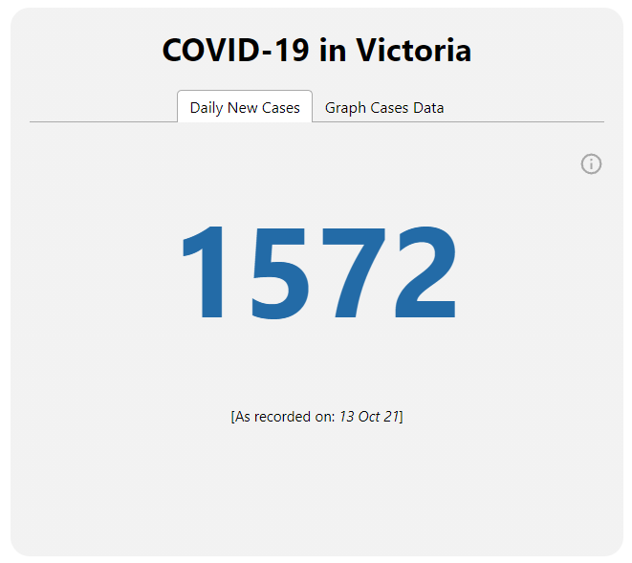
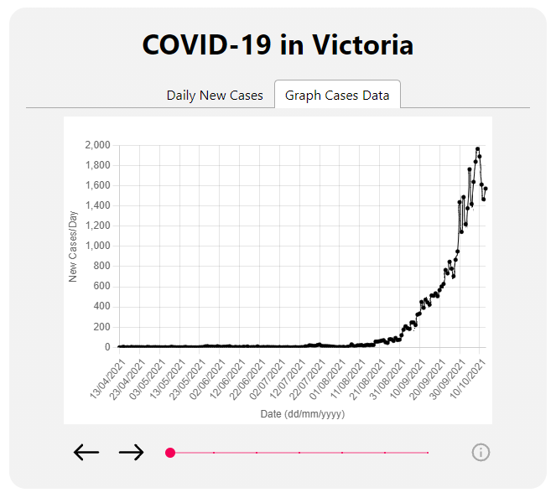
COVID-19 in Victoria Widget
Victoria’s Daily New Cases
Victoria’s Data Graph

Slide 7
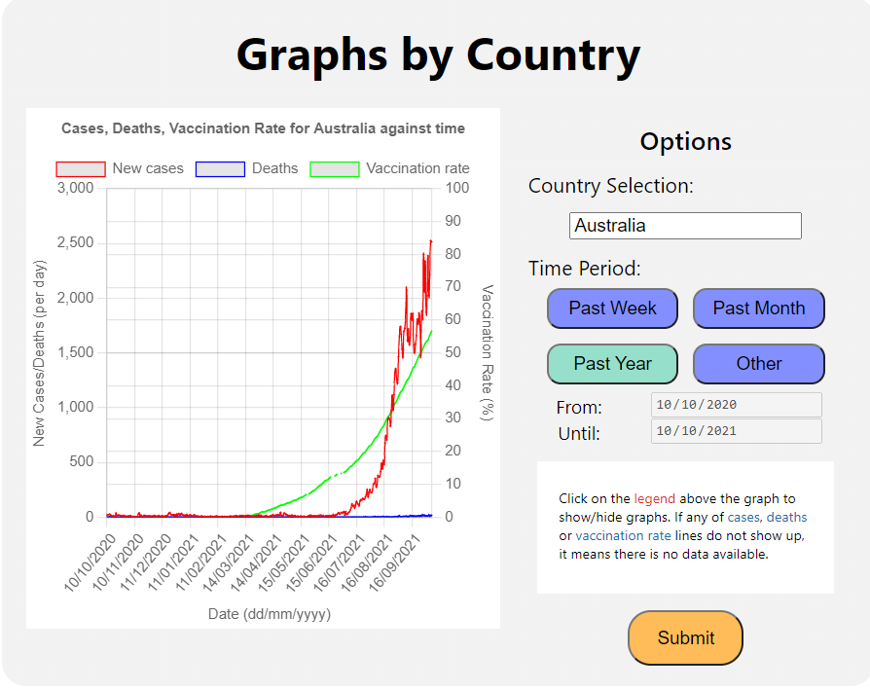
Graph By Country Widget

Slide 8
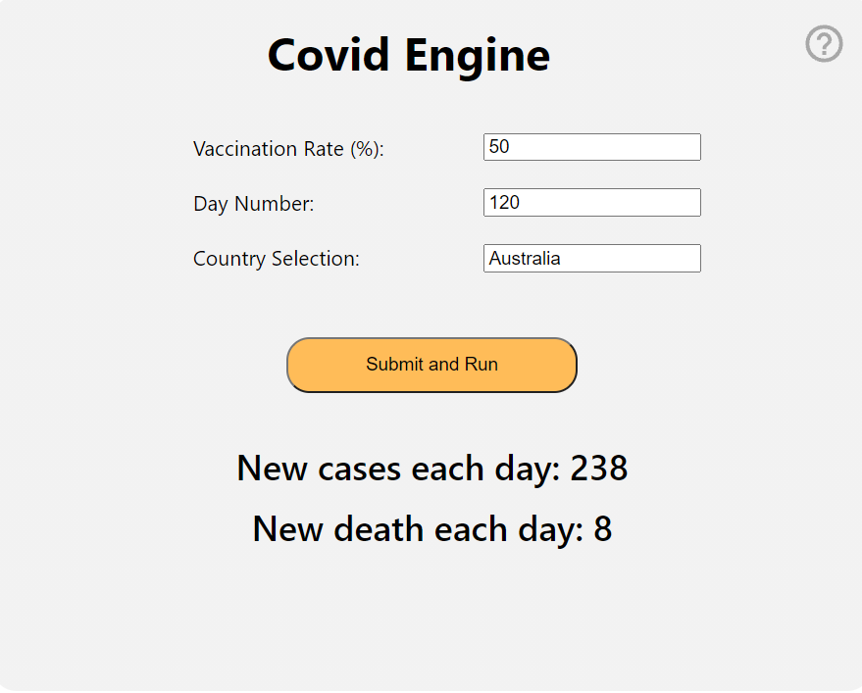
Covid Engine Widget

Slide 9
Features Demonstration

Slide 10
Definition of Done
All product backlog items related to the feature is completed or negotiated for change
Feature function as per specified
Testing
Unit testing to ensure no unexpected issues or bugs arise in individual feature
Integration testing to ensure features function correctly when working together, and that they do not interfere with each other
All completed code and files required by the feature is pushed to git
Every team member is satisfied with the product prior to delivery
This is verified during the product review meeting after sprints where developers will presentation their features
Other members can provide feedback on the product
Results/Response of all user operations should display or occur within 5 seconds assuming the availability of data/API, a stable internet connection of at least 20 Mbps with a functioning computer with standard specs.

Slide 11
Velocity
Initial total estimated: 107 hours
Estimated Velocity: 35 Hours / Sprint
Sprint 1: 38 Hours
Sprint 2: 50 hours
Sprint 3: 40 hours (project completed)
Actual total hours: 128 hours

Slide 12
Limitations
API dependency
Reliability and accuracy of data
Access and format of information
Limitation on information available
Graph of victoria
Does not retain the same y axis scale as date range changes
Small fluctuations in data and effects of smoothing is easier to observe

Slide 13
Conclusion
Thank you for listening
Link to our web app will now be in the chat!

